Slide 1
Mike Bostock
Design Presentation

Slide 2

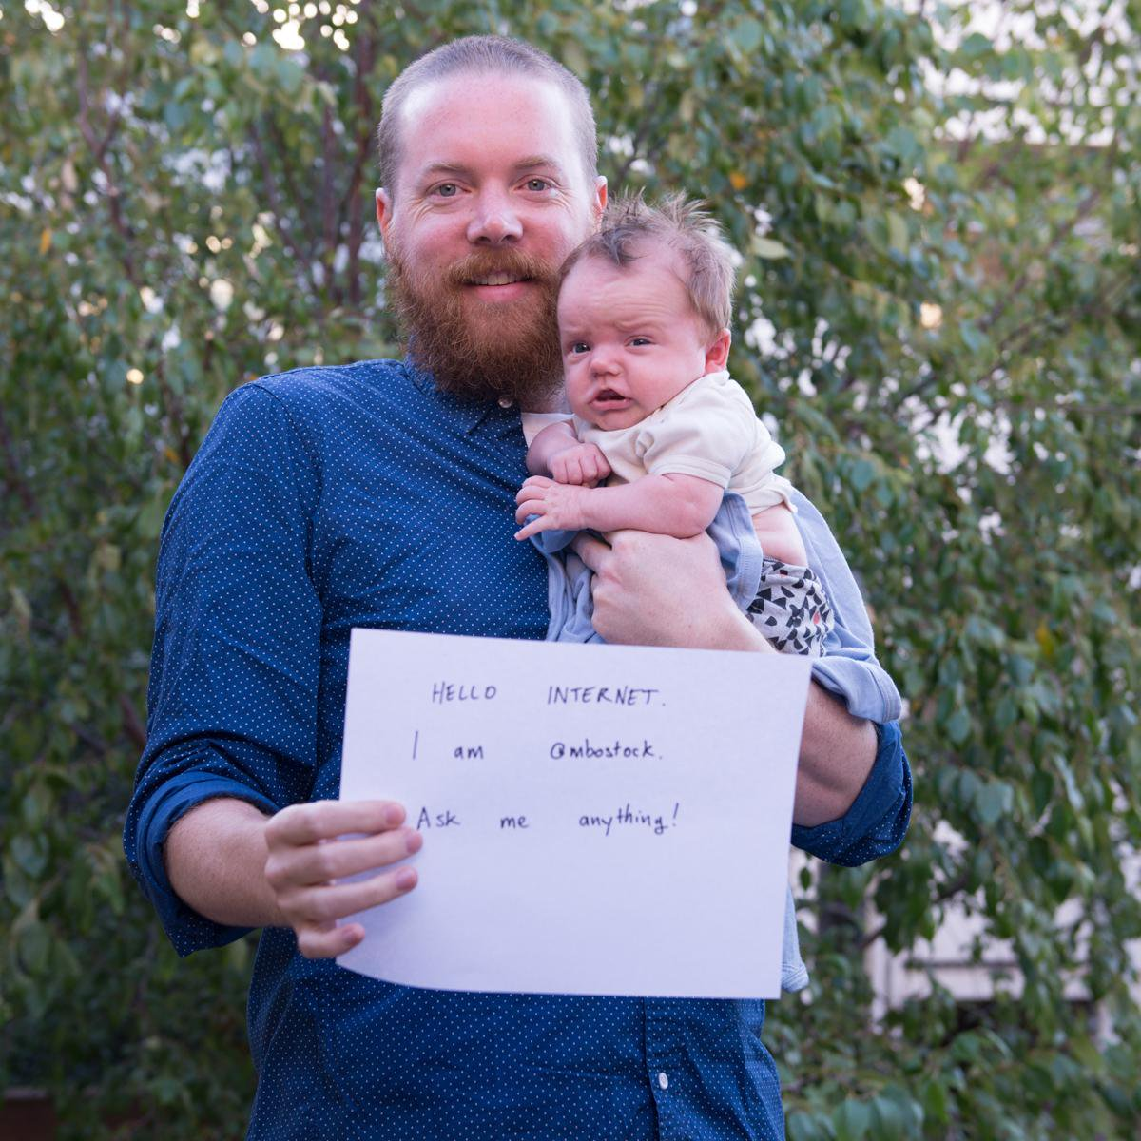
Biography
Creator of D3.js, an open-source JavaScript library for data visualization
Until recently, a graphics editor for The New York Times, and described as a “digital superstar”
Studies information visualization at Standford University. Got a BSE in computer science at Princeton, specifically focused on Human-Computer Interaction (the design and use of computer technology, focused on the interface with people).
Influences he sights:
the book The Design of Everyday Things by Don Norman as the introduction to design thinking
Edward Tufte

Slide 3
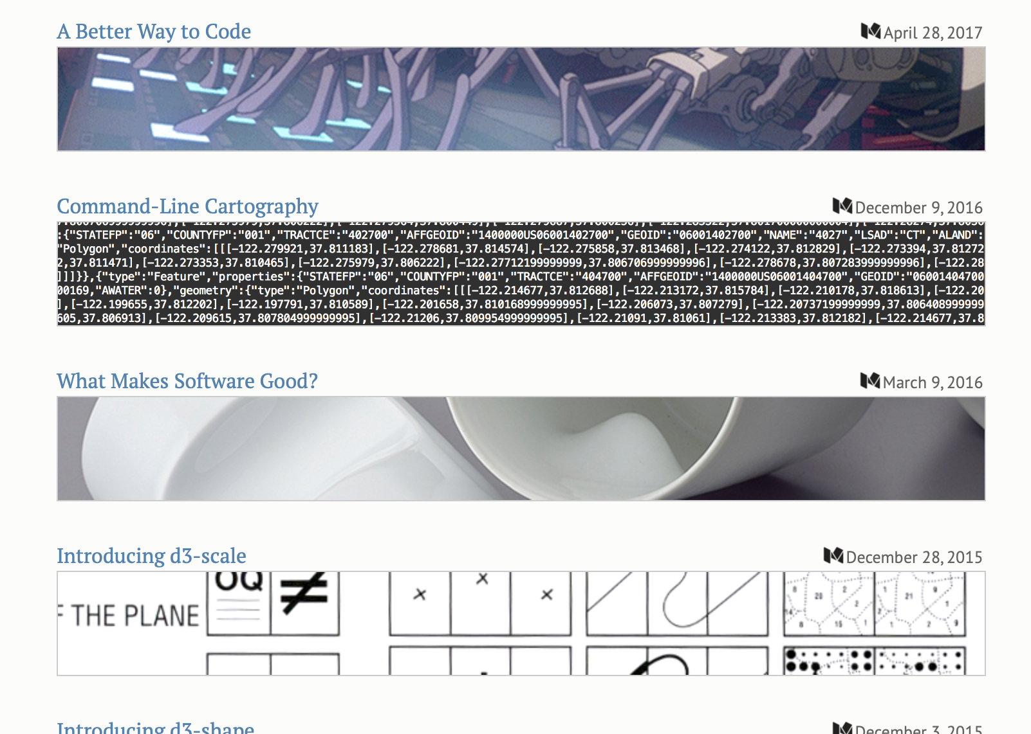
“A lot of the work I do is born out of frustration and channeling that frustration into something productive… I am interested in making code easier to understand.”
D3
Library in JavaScript that binds data to DOM elements
Allows for high degree of customization
Revolutionized interactive visualization
Blocks and Observable
Dynamic coding notebooks that allow for iterations of projects by different people
Collaborative code remixing
Not limited to d3
https://observablehq.com/@mbostock/slide

Slide 4
Mapping the Spread of Drought Across the US
https://www.nytimes.com/interactive/2014/upshot/mapping-the-spread-of-drought-across-the-us.html
Notes:
Posted on the Upshot
April 2015
Uses d3
Color choice
Graph Choice

Slide 5
Front Row to Fashion Week
http://www.nytimes.com/newsgraphics/2014/02/14/fashion-week-editors-picks/index.html

Slide 6
'Stop and Frisk’ is All but Gone From New York
https://www.nytimes.com/interactive/2014/09/19/nyregion/stop-and-frisk-is-all-but-gone-from-new-york.html

Slide 7
The Most Detailed Maps You’ll See From the Midterm Elections
https://www.nytimes.com/interactive/2014/11/04/upshot/senate-maps.html

Slide 8
More Projects
He publishes detailed tutorials on creating visualizations using open-source tools: https://medium.com/@mbostock/command-line-cartography-part-1-897aa8f8ca2c
He writes thoughtful pieces on design thinking and software development: https://medium.com/@mbostock/what-makes-software-good-943557f8a488
He writes about the conceptual ideas that drove the creation of d3.js, and critiques the art of “writing code”: https://medium.com/@mbostock/a-better-way-to-code-2b1d2876a3a0

Slide 9
Reflections
The good and the bad
“Design is a search problem… We need to be able to spend time exploring things that don’t work to find the things that do work... How do establish a process for design that recognizes the inevitability of failure and the necessity of trial and error?“

